Slide 1
Graduate RotationaL Internship Program
THE SPARKS FOUNDATION
Prediction using Supervised ML
(Level - Beginner)
Submitted By,
Jeenath S,
B.E-Computer Science and Engineering,
Bharathiyar Institute of Engineering for Women,
Attur, Salem

Slide 2
Problem Statement
● Predict the percentage of an student based on the no. of study hours.
● This is a simple linear regression task as it involves just 2 variables.
● You can use R, Python, SAS Enterprise Miner or any other tool
● Data can be found at http://bit.ly/w-data
● What will be predicted score if a student studies for 9.25 hrs/ day?
● Sample Solution : https://bit.ly/2HxiGGJ

Slide 3

First You NEED TO UNDERSTAND
What is Supervsied Learning?
When we use Linear Regression Algorithm?

Slide 4
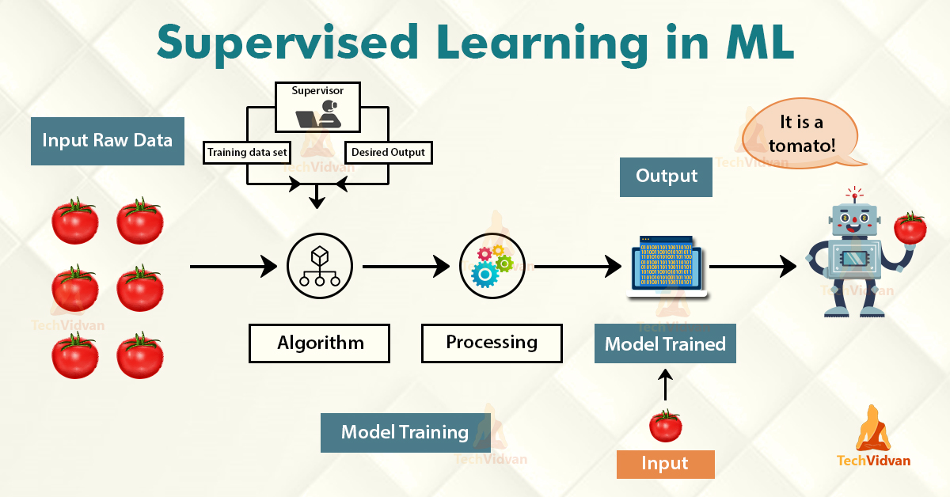
Supervised Ml

Slide 5
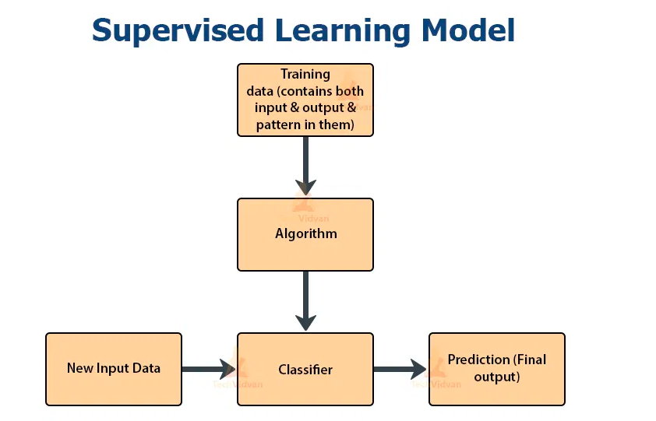
Flowchart

Slide 6
REGRESSION ML
It is an ML algorithm, which includes modelling with the help of a dependent variable.
As the name suggests, this is a linear model.
The format of the projection for this model is Y= ax+b.
Linear regression is an algorithm, which helps us to understand the relationship between two variables.

Slide 7
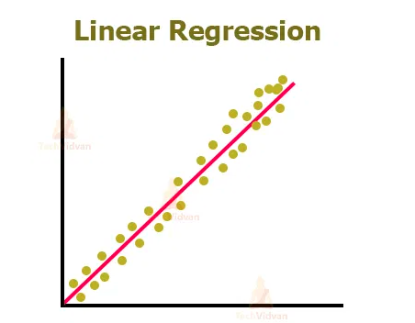
Linear regression Model

Slide 8
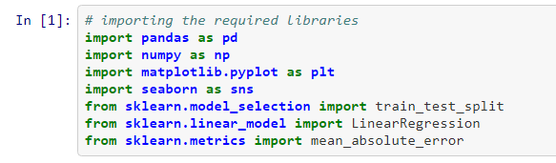
Step 1: Importing all libraries required in this notebook

Slide 9

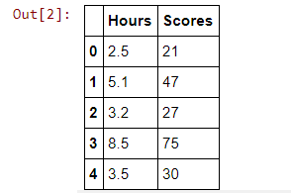
Step 2 Reading data from csv file and visualization

Slide 10
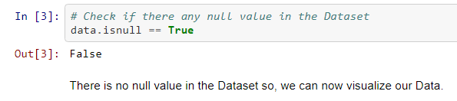
STEP 3: Check the data if anything is null

Slide 11
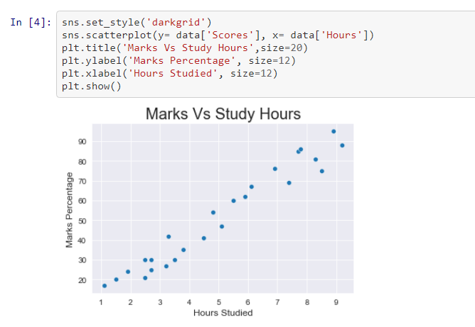
Visualize the given values

Slide 12
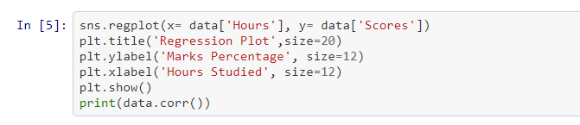
STEp 3: Regression plot
From the above scatter plot there looks to be correlation between the 'Marks Percentage' and 'Hours Studied’,
Lets plot a regression line to confirm the correlation.

Slide 13
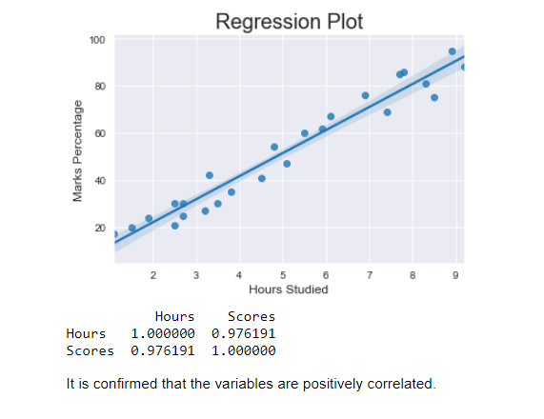
Plot look like

Slide 14
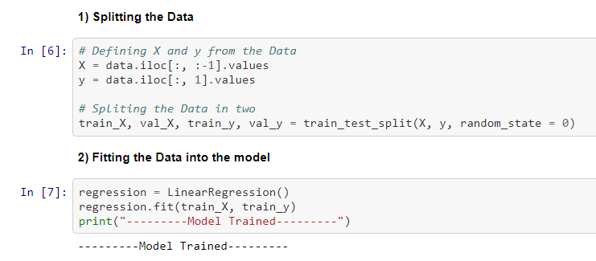
Step :4 Training the Model

Slide 15
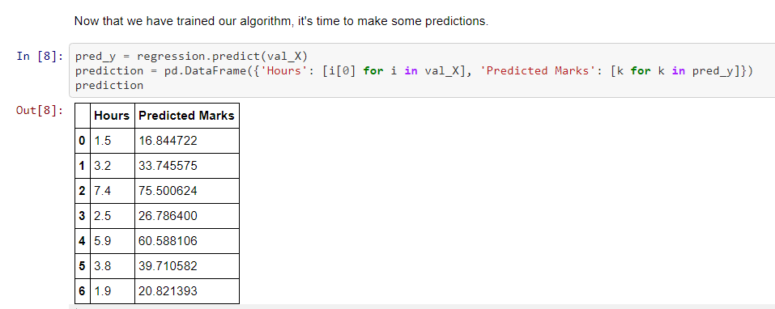
Step 5 Making Predictions

Slide 16
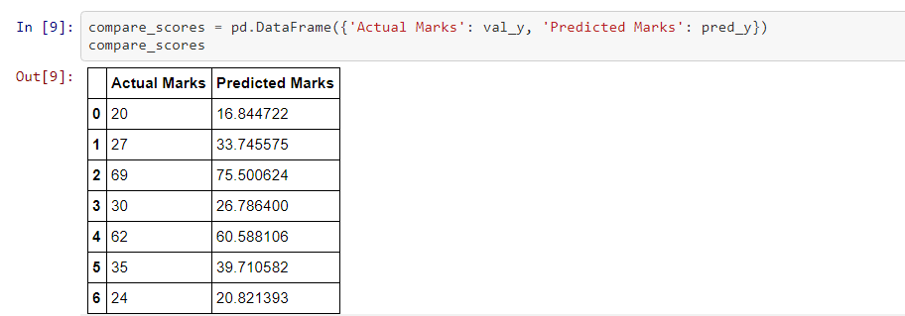
Comparing the Predicted Marks with the Actual Marks

Slide 17
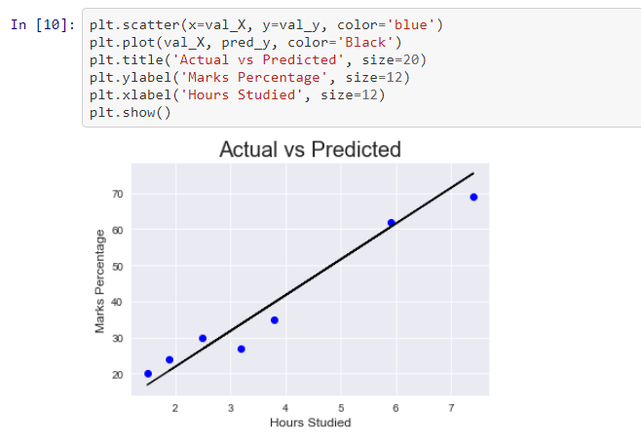
Visually Comparing the Predicted Marks with the Actual Marks

Slide 18

Step 6 Evaluating the model
Small value of Mean absolute error states that the chances of error or wrong forecasting through the model are very less.

Slide 19
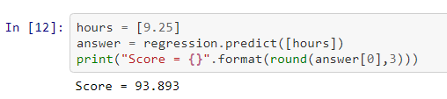
Solution
According to the regression model if a student studies for 9.25 hours a day he/she is likely to score 93.89 marks.

Slide 20
Reference
Please check my github repository : https://github.com/jeenaths/Supervised-ML/blob/main/Prediction_Using_Supervised_ML.ipynb
Data can be found at http://bit.ly/w-data
Thanks & Regards,
Jeenath S,
B.E - CSE

